Slide 1
Circulating cell-free RNA to predict pregnancy trimester
Jessie Bologna
Lindsay Reisman

Slide 2
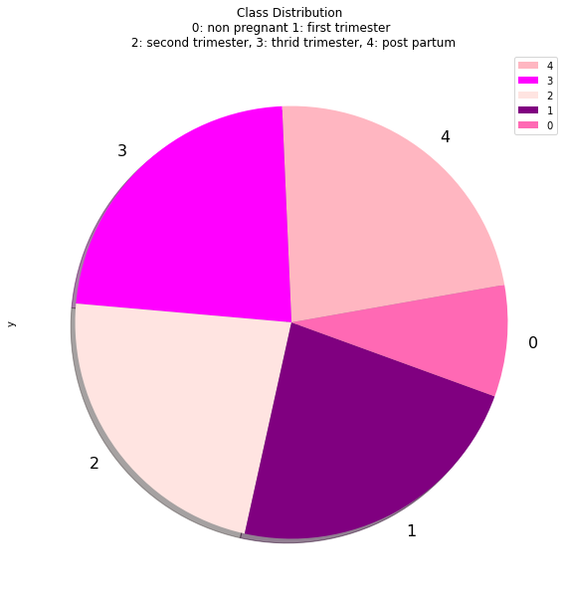
Dataset Summary
From GEO database: Microarray data of cell-free RNA collected at different stages during pregnancy
48 samples - 12 patients
5 classes -
First trimester
Second trimester
Third trimester
Postpartum
control/ non-pregnant
33,297 genes - expression values
(Koh et al., 2014)

Slide 3
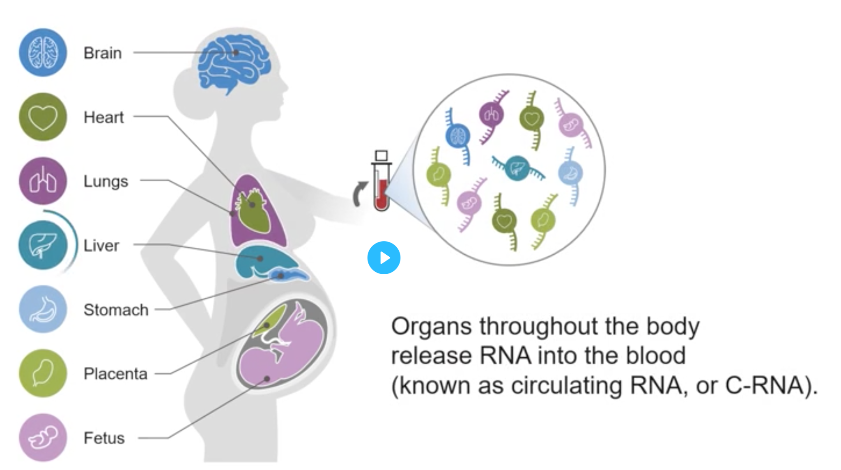
What is cell-free RNA?
Circulating cell-free RNA in the blood can identify the health and development of various organs during pregnancy by monitoring gene expression levels.
Our goal: Using this dataset we would like to predict what trimester a patient is in based on expression levels.
Yirka © 2020 Science X Network

Slide 4
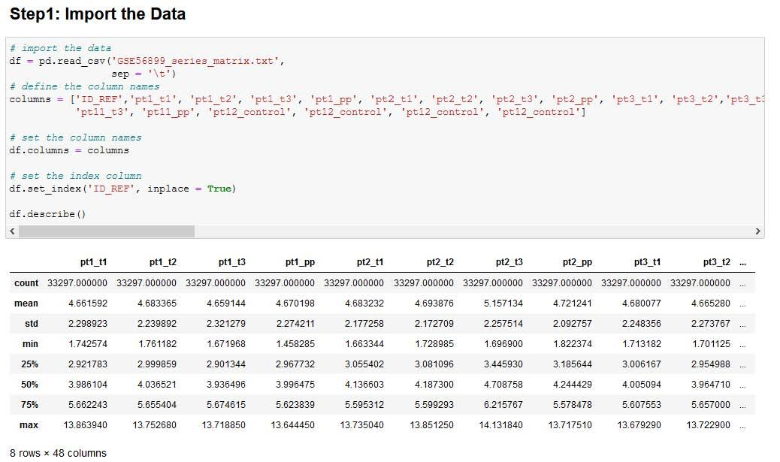
Step 1: Loading the Data

Slide 5
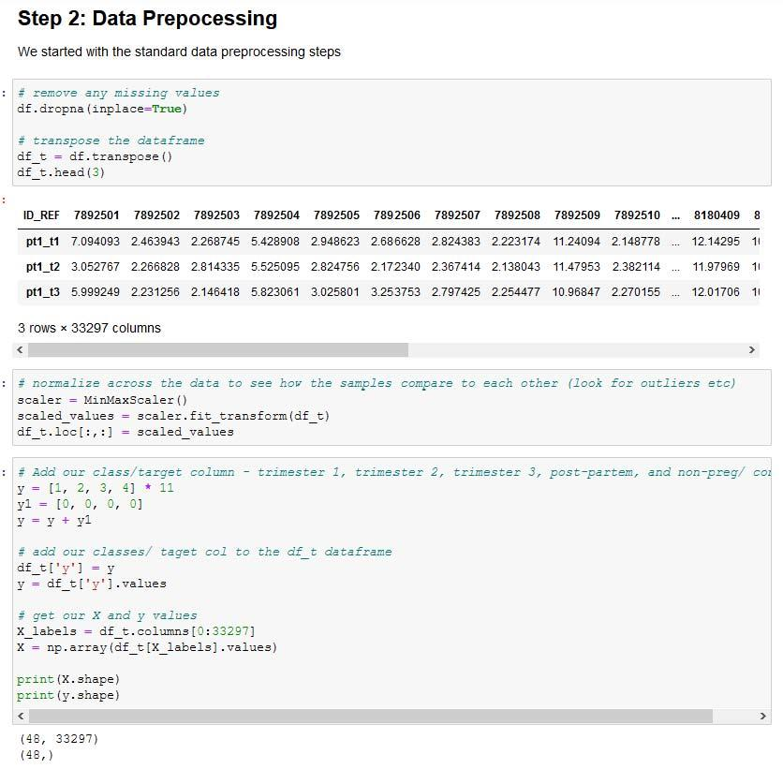
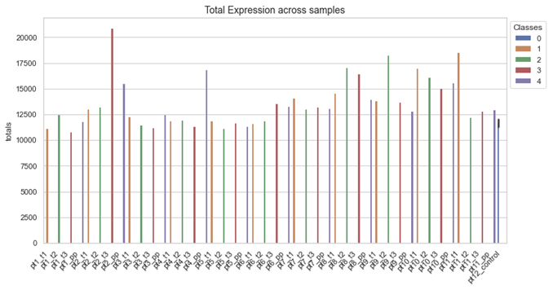
Step 2: Data preprocessing
We started with some standard data preprocessing steps:
Remove missing values
Transpose the data
Normalized across the genes
Split the data into X and y matrices

Slide 6
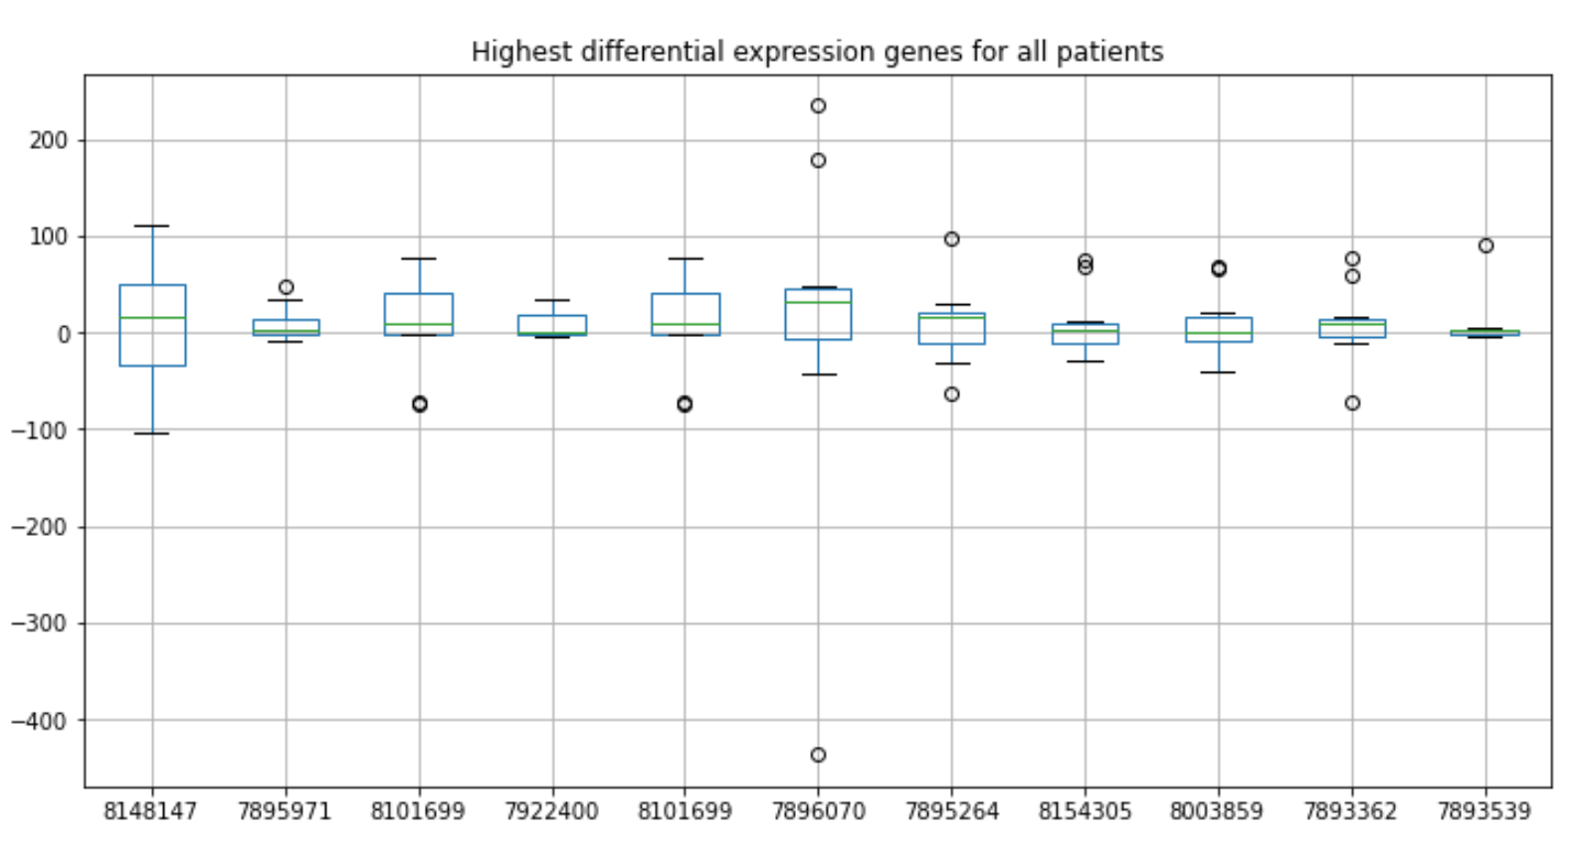
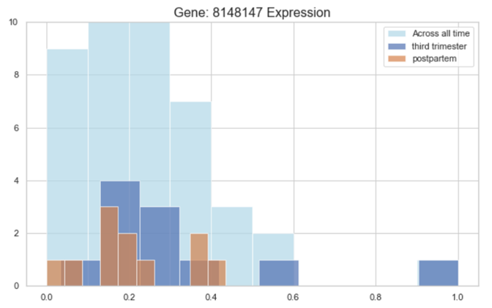
Step 2: Data preprocessing - part2
Additional preprocessing step needed:
Created a new dataframe containing only genes with the highest variability between time periods. We chose to look at differential transcript expression between just the 3rd trimester and postpartum.

Slide 7
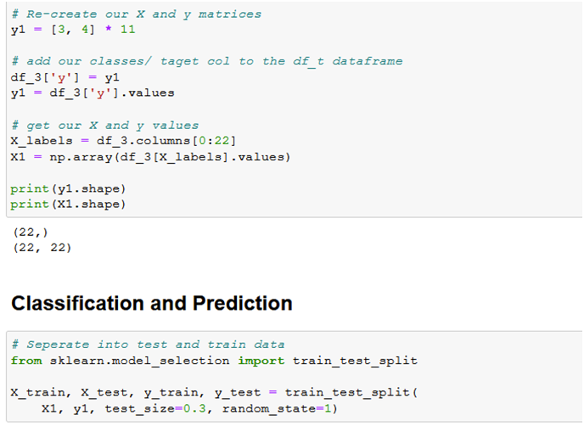
Step 3: Setting up/ running models
We ran various different models to determine which model best fit our dataset with a high accuracy rate.
To set up our model we:
Resplit our top genes dataframe into X and y matrices
Separate into test and train data

Slide 8
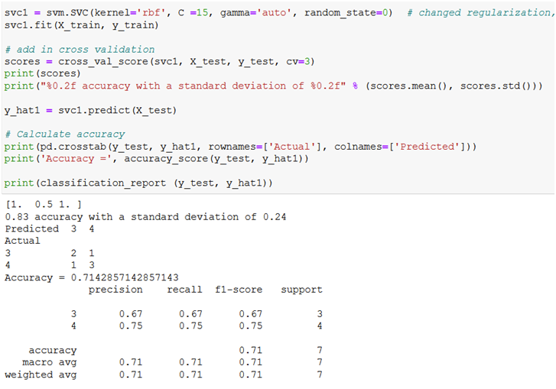
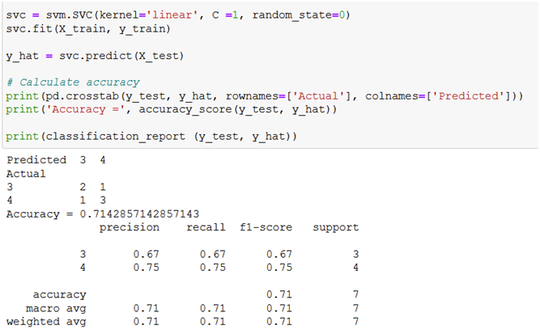
Step 3: Model Analysis: SVM
SVM: Updated parameters
SVM: Standard

Slide 9
Conclusions/ final thoughts
Based on the accuracy of all the models initially ran, it is difficult to accurately predict the trimester of a patient from trimester 1 to trimester 3.
Therefore, we decided to look at the data differently from our initial hypothesis and predicted based on expression level during the 3rd trimester vs after delivery, when fetal expression levels drop rapidly
Some overall considerations:
Expression levels vary during pregnancy depending on the tissue/organ as well as the individual
More data processing/analysis needed: Need to focus on genes with lower expression levels
More patients to study

Slide 10
References:
Koh W, Pan W, Gawad C, Fan HC et al. (May 20, 2014). Noninvasive in vivo monitoring of tissue-specific global gene expression in humans. Proc Natl Acad Sci USA;111(20):7361-6. PMID: 24799715

